Slide 1
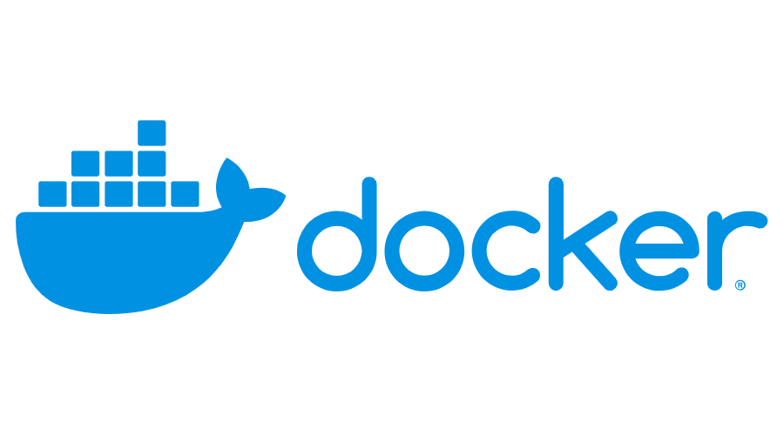
Domain 2 – Image Creation, Management and Registry
Created by :Rajagopal K
670334

Slide 2
DOMAIN – 2
Image Creation, Management, and Registry
Dockerfile reference :
Docker can build images automatically by reading the instructions from a Dockerfile. A Dockerfile is a text document that contains all the commands a user could call on the command line to assemble an image. Using docker build users can create an automated build that executes several command-line instructions in succession
Docker Build :
The docker build command builds an image from a Dockerfile and a context. The build’s context is the set of files at a specified location PATH or URL. The PATH is a directory on your local filesystem. The URL is a Git repository location.
A context is processed recursively. So, a PATH includes any subdirectories and the URL includes the repository and its submodules. This example shows a build command that uses the current directory as context:
$ docker build .
Sending build context to Docker daemon 6.51 MB ...
The build is run by the Docker daemon, not by the CLI. The first thing a build process does is send the entire context (recursively) to the daemon. In most cases, it’s best to start with an empty directory as context and keep your Dockerfile in that directory. Add only the files needed for building the Dockerfile.
Warning: Do not use your root directory, /, as the PATH as it causes the build to transfer the entire contents of your hard drive to the Docker daemon.
To use a file in the build context, the Dockerfile refers to the file specified in an instruction, for example, a COPY instruction. To increase the build’s performance, exclude files and directories by adding a .dockerignore file to the context directory.

Slide 3
Traditionally, the Dockerfile is called Dockerfile and located in the root of the context. You use the -f flag with docker build to point to a Dockerfile anywhere in your file system.
$ docker build -f /path/to/a/Dockerfile .
You can specify a repository and tag at which to save the new image if the build succeeds:
$ docker build -t shykes/myapp .
To tag the image into multiple repositories after the build, add multiple -t parameters when you run the build command:
$ docker build -t shykes/myapp:1.0.2 -t shykes/myapp:latest .
Before the Docker daemon runs the instructions in the Dockerfile, it performs a preliminary validation of the Dockerfile and returns an error if the syntax is incorrect:
$ docker build -t test/myapp .
Sending build context to Docker daemon 2.048 kB Error response from daemon:
Unknown instruction: RUNCMD
The Docker daemon runs the instructions in the Dockerfile one-by-one, committing the result of each instruction to a new image if necessary, before finally outputting the ID of your new image. The Docker daemon will automatically clean up the context you sent.
Whenever possible, Docker will re-use the intermediate images (cache), to accelerate the docker buildprocess significantly. This is indicated by the Using cache message in the console output

Slide 4
Sample Output :
$ docker build -t svendowideit/ambassador .
Sending build context to Docker daemon 15.36 kB
Step 1/4 : FROM alpine:3.2
---> 31f630c65071
Step 2/4 : MAINTAINER SvenDowideit@home.org.au
---> Using cache
---> 2a1c91448f5f
Step 3/4 : RUN apk update && apk add socat && rm -r /var/cache/
---> Using cache
---> 21ed6e7fbb73
Step 4/4 : CMD env | grep _TCP= | (sed 's/.*_PORT_\([0-9]*\)_TCP=tcp:\/\/\(.*\):\(.*\)/socat -t 100000000 TCP4-LISTEN:\1,fork,reuseaddr TCP4:\2:\3 \&/' && echo wait) | sh
---> Using cache
---> 7ea8aef582cc
Successfully built 7ea8aef582cc

Slide 5
DOCKER FILE OPTIONS
FROM :
The FROM instruction initializes a new build stage and sets the Base Image for subsequent instructions. As such, a valid Dockerfile must start with a FROM instruction.
Eg:
FROM <image>[:<tag>] [AS <name>]
ARG :
ARG is the only instruction that may precede FROM in the Dockerfile
Eg:
ARG VERSION=latest
FROM busybox:$VERSION
RUN :
RUN has 2 forms:
RUN <command> (shell form, the command is run in a shell, which by default is /bin/sh -c on Linux or cmd /S /C on Windows)
RUN ["executable", "param1", "param2"] (exec form)
The RUN instruction will execute any commands in a new layer on top of the current image and commit the results. The resulting committed image will be used for the next step in the Dockerfile
Eg:
RUN yum install elinks

Slide 6
CMD :
The CMD instruction has three forms:
CMD ["executable","param1","param2"] (exec form, this is the preferred form)
CMD ["param1","param2"] (as default parameters to ENTRYPOINT)
CMD command param1 param2 (shell form)
There can only be one CMD instruction in a Dockerfile. If you list more than one CMD then only the last CMD will take effect.
The main purpose of a CMD is to provide defaults for an executing container. These defaults can include an executable.
Eg:
CMD javac sample.java
LABEL :
The LABEL instruction adds metadata to an image. A LABEL is a key-value pair. To include spaces within a LABEL value, use quotes and backslashes as you would in command-line parsing.
Eg:
LABEL version="1.0"
LABEL description="This text illustrates “
MAINTAINER :
The MAINTAINER instruction sets the Author field of the generated images.
Eg:
MAINTAINER Raja

Slide 7
ADD :
ADD has two forms:
ADD [--chown=<user>:<group>] <src>... <dest>
ADD [--chown=<user>:<group>] ["<src>",... "<dest>"] (this form is required for paths containing whitespace)
The ADD instruction copies new files, directories or remote file URLs from <src> and adds them to the filesystem of the image at the path <dest>.
Eg:
ADD test relativeDir/ # adds "test" to `WORKDIR`/relativeDir/
COPY :
COPY has two forms:
COPY [--chown=<user>:<group>] <src>... <dest>
COPY [--chown=<user>:<group>] ["<src>",... "<dest>"] (this form is required for paths containing whitespace)
The COPY instruction copies new files or directories from <src> and adds them to the filesystem of the container at the path <dest>.
Eg:
COPY hom* /mydir/ # adds all files starting with "hom"

Slide 8
ENTRYPOINT :
ENTRYPOINT has two forms:
ENTRYPOINT ["executable", "param1", "param2"] (exec form, preferred)
ENTRYPOINT command param1 param2 (shell form)
An ENTRYPOINT allows you to configure a container that will run as an executable.
Eg:
ENTRYPOINT java –jar Jenkins.war
Understand how CMD and ENTRYPOINT interact
Both CMD and ENTRYPOINT instructions define what command gets executed when running a container. There are few rules that describe their co-operation.
Dockerfile should specify at least one of CMD or ENTRYPOINT commands.
ENTRYPOINT should be defined when using the container as an executable.
CMD should be used as a way of defining default arguments for an ENTRYPOINT command or for executing an ad-hoc command in a container.
CMD will be overridden when running the container with alternative arguments
ENV :
The ENV instruction sets the environment variable <key> to the value <value>. This value will be in the environment for all subsequent instructions in the build stage and can be replaced inline in many as well.
Eg:
ENV myName John Doe

Slide 9
Other Dockerfile options :
Expose
Volume
Workdir
User
Onbuild
Stopsignal
Healthcheck
Shell
LINK : https://docs.docker.com/engine/reference/builder/
Sample Dockerfile :
ARG version=7
FROM centos:$version
MAINTAINER Raja
LABEL manufacturer="redhat"
COPY . /var/lib/temp/
ADD http://mirrors.jenkins.io/war-stable/latest/jenkins.war /var/lib/jenkins/
RUN yum install -y elinks
ENTRYPOINT java -jar /var/lib/jenkins/jenkins.war

Slide 10
Best practices for writing Dockerfiles :
Exclude with .dockerignore :
To exclude files not relevant to the build (without restructuring your source repository) use a .dockerignore file. This file supports exclusion patterns similar to .gitignore files.
Use multi-stage builds :
Multi-stage builds allow you to drastically reduce the size of your final image, without struggling to reduce the number of intermediate layers and files.
Because an image is built during the final stage of the build process, you can minimize image layers by leveraging build cache.
Don’t install unnecessary packages :
To reduce complexity, dependencies, file sizes, and build times, avoid installing extra or unnecessary packages
Minimize the number of layers :
In older versions of Docker, it was important that you minimized the number of layers in your images to ensure they were performant. The following features were added to reduce this limitation:
Only the instructions RUN, COPY, ADD create layers. Other instructions create temporary intermediate images, and do not increase the size of the build.
Where possible, use multi-stage builds, and only copy the artifacts you need into the final image. This allows you to include tools and debug information in your intermediate build stages without increasing the size of the final image.

Slide 11
About storage drivers :
To use storage drivers effectively, it’s important to know how Docker builds and stores images, how these images are used by containers. You can use this information to make informed choices about the best way to persist data from your applications and avoid performance problems along the way.
Storage drivers allow you to create data in the writable layer of your container. The files won’t be persisted after the container stops, and both read and write speeds are low.
Learn how to use volumes to persist data and improved performance.
Images and layers :
A Docker image is built up from a series of layers. Each layer represents an instruction in the image’s Dockerfile. Each layer except the very last one is read-only. Consider the following Dockerfile:
FROM ubuntu:15.04
COPY . /app
RUN make /app
CMD python /app/app.py

Slide 12
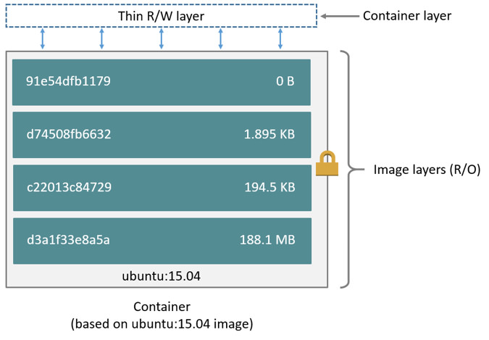
This Dockerfile contains four commands, each of which creates a layer. The FROM statement starts out by creating a layer from the ubuntu:15.04 image. The COPY command adds some files from your Docker client’s current directory. The RUN command builds your application using the make command. Finally, the last layer specifies what command to run within the container.
Each layer is only a set of differences from the layer before it. The layers are stacked on top of each other. When you create a new container, you add a new writable layer on top of the underlying layers. This layer is often called the “container layer”. All changes made to the running container, such as writing new files, modifying existing files, and deleting files, are written to this thin writable container layer. The diagram below shows a container based on the Ubuntu 15.04 image.
A storage driver handles the details about the way these layers interact with each other. Different storage drivers are available, which have advantages and disadvantages in different situations.

Slide 13
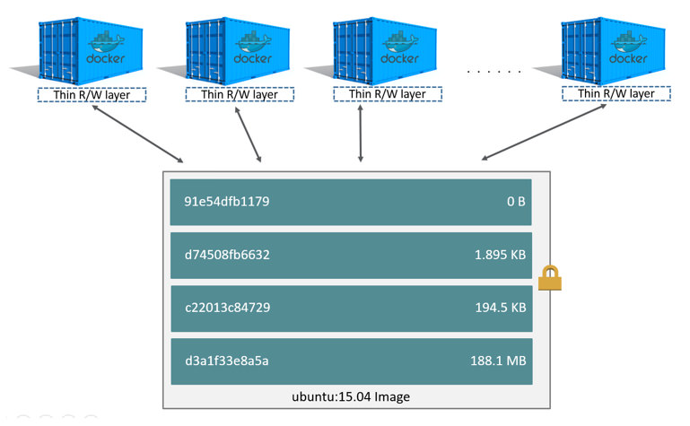
Container and layers :
The major difference between a container and an image is the top writable layer. All writes to the container that add new or modify existing data are stored in this writable layer. When the container is deleted, the writable layer is also deleted. The underlying image remains unchanged.
Because each container has its own writable container layer, and all changes are stored in this container layer, multiple containers can share access to the same underlying image and yet have their own data state. The diagram below shows multiple containers sharing the same Ubuntu 15.04 image.
Note: If you need multiple images to have shared access to the exact same data, store this data in a Docker volume and mount it into your containers.
Docker uses storage drivers to manage the contents of the image layers and the writable container layer. Each storage driver handles the implementation differently, but all drivers use stackable image layers and the copy-on-write (CoW) strategy.

Slide 14
$ docker pull ubuntu:15.04
15.04: Pulling from library/ubuntu
1ba8ac955b97: Pull complete
f157c4e5ede7: Pull complete
0b7e98f84c4c: Pull complete
a3ed95caeb02: Pull complete
Digest: sha256:5e279a9df07990286cce22e1b0f5b0490629ca6d187698746ae5e28e604a640e
Status: Downloaded newer image for ubuntu:15.04
Each of these layers is stored in its own directory inside the Docker host’s local storage area. To examine the layers on the filesystem, list the contents of /var/lib/docker/<storage-driver>/layers/. This example uses aufs, which is the default storage driver:
$ ls /var/lib/docker/aufs/layers
1d6674ff835b10f76e354806e16b950f91a191d3b471236609ab13a930275e24
5dbb0cbe0148cf447b9464a358c1587be586058d9a4c9ce079320265e2bb94e7
bef7199f2ed8e86fa4ada1309cfad3089e0542fec8894690529e4c04a7ca2d73
ebf814eccfe98f2704660ca1d844e4348db3b5ccc637eb905d4818fbfb00a06a

Slide 15
Docker image commands :
docker image build | Build an image from a Dockerfile
docker image history | Show the history of an image
docker image import | Import the contents from a tarball to create a filesystem image
docker image inspect | Display detailed information on one or more images
docker image load | Load an image from a tar archive or STDIN
docker image ls | List images
docker image prune | Remove unused images
docker image pull | Pull an image or a repository from a registry
docker image push | Push an image or a repository to a registry
docker image rm | Remove one or more images
docker image save | Save one or more images to a tar archive (streamed to STDOUT by default)
docker image tag | Create a tag TARGET_IMAGE that refers to SOURCE_IMAGE

Slide 16
REFERENCE LINKS
Describe Dockerfile options
Show the main parts of a Dockerfile
Give examples on how to create an efficient image via a Dockerfile
Use CLI commands such as list delete prune rmi etc to manage images
Inspect images and report specific attributes using filter and format
Demonstrate tagging an image
Utilize a registry to store an image
Display layers of a Docker image
Apply a file to create a Docker image
Modify an image to a single layer
Describe how image layers work
Deploy a registry
Configure a registry
Log into a registry
Utilize search in a registry
Tag an image
Push an image to a registry
Sign an image in a registry
Pull an image from a registry
Describe how image deletion works
Delete an image from a registry

Slide 17
THANK YOU

